Slide 1


Slide 2
Git
Version Control Strategy
By
Vidhya
Yuvarani
SreeVidhya
Yuvarani, Vidhya, SreeVidya ( Interns) 7-Oct-2024

Slide 3

Use Case
Design a version control strategy using Git? Describe your approach for branching, merging, and handling different releases.

Slide 4
Version Control Strategy
A systematic approach to managing code changes.
Helps teams collaborate efficiently.
Maintains project stability and history.

Slide 5
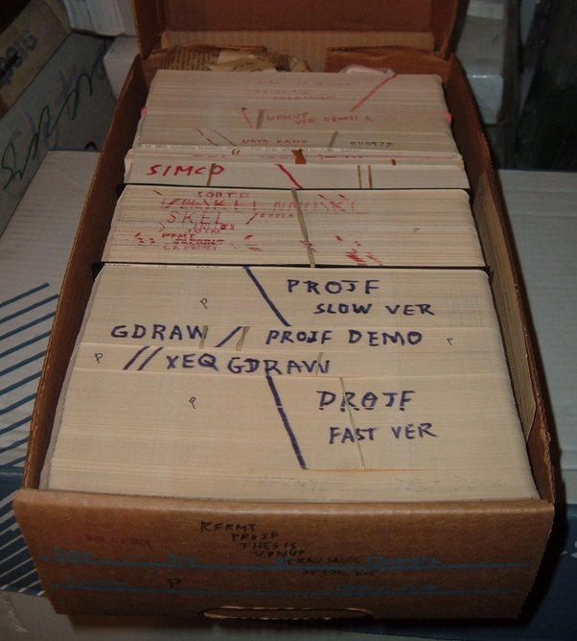
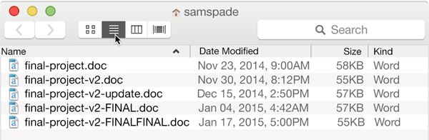
How Project are managed before version control

Slide 6
Why It is Important
No Code Tracking
No History
Merge Conflicts
No Accountability
Collaboration Issues

Slide 7
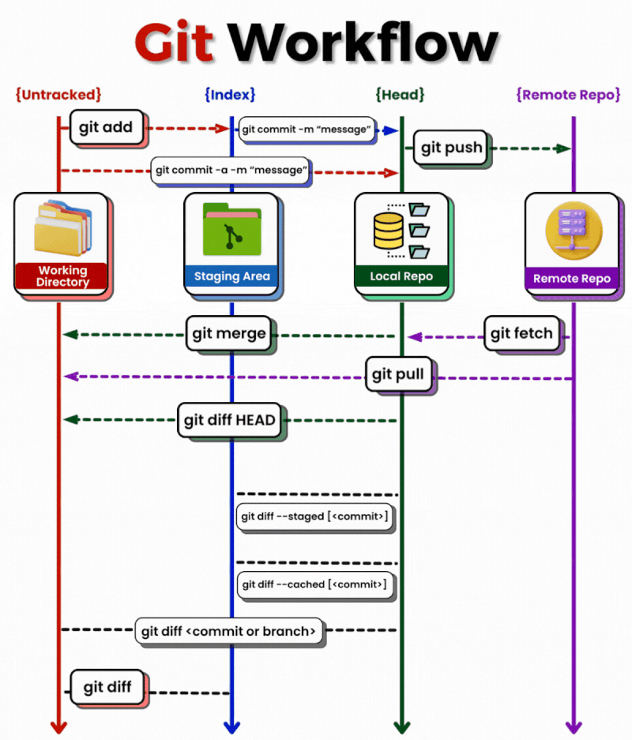
Git Workflow
Modify files in your working directory.
Stage files, adding snapshots of them to your staging area.
Commit changes to the Local Repository with git commit.
Sync changes with the Remote Repository using git push.

Slide 8
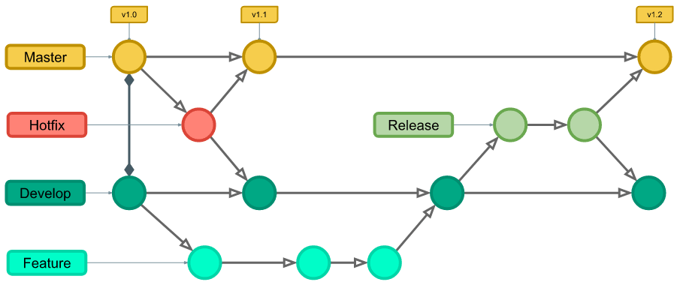
Branching Strategy
A branching strategy defines how branches are used to manage code development and collaboration in a Git repository.
Common Git Branches:
Main/Master
Develop
Feature Branch
Release Branch
Hotfix Branch

Slide 9
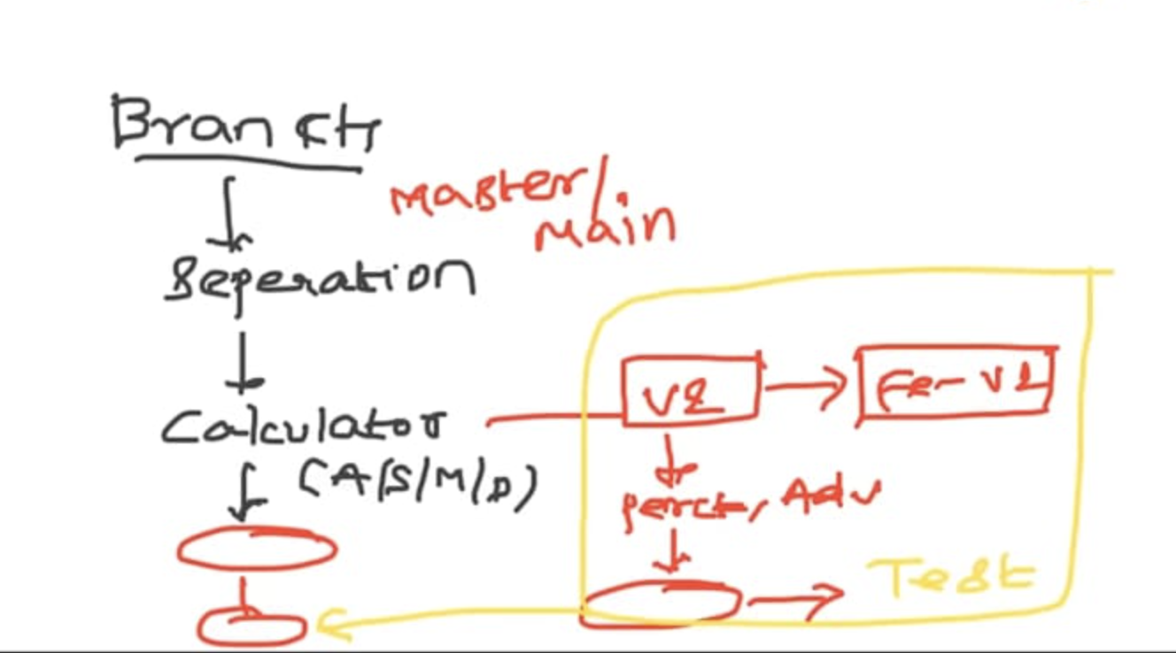
Example
Branches - Master, Develop, Feature, Release, Hotfix

Slide 10
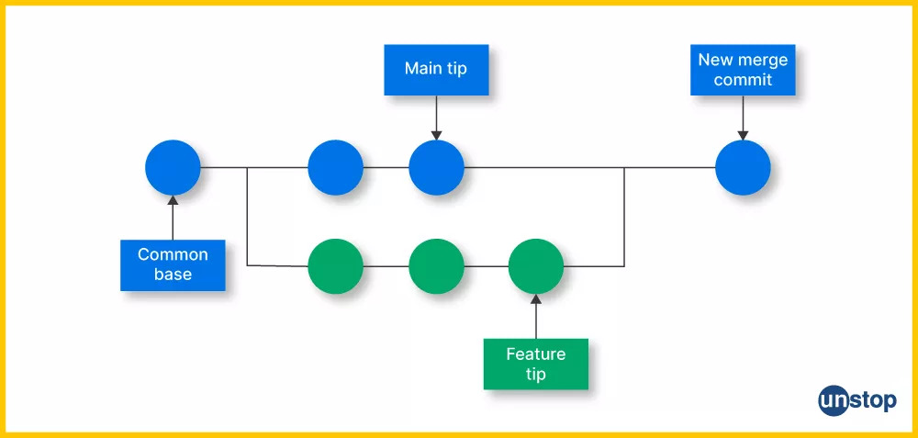
Merging Strategies
Various ways of merging in Git
Fast Forward
Squash
Rebase and merge
Three way merge

Slide 11
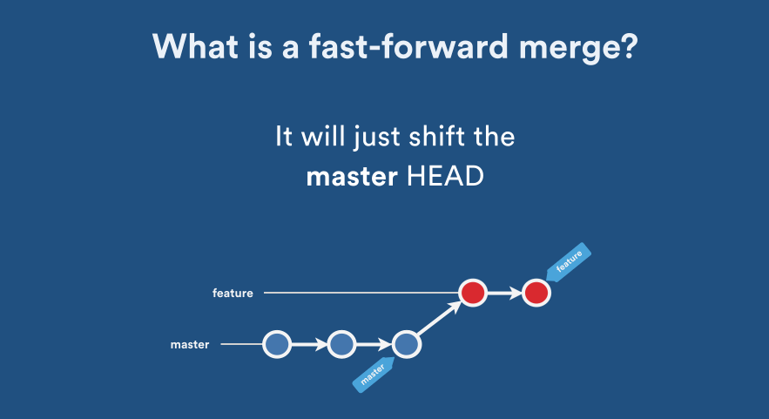
Fast Forward Merge
Happens when there are no commits on the base branch since the feature branch was created
Simply moves the pointer forward without creating a new commit.
Advantage : It keeps the history clean and linear.

Slide 12
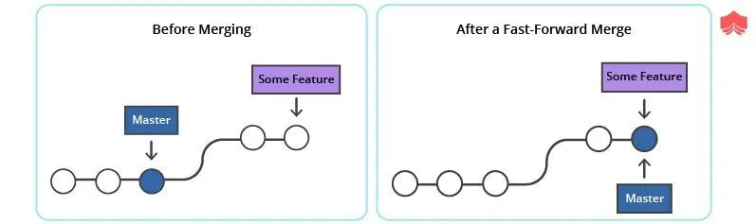
Example Scenario

Slide 13
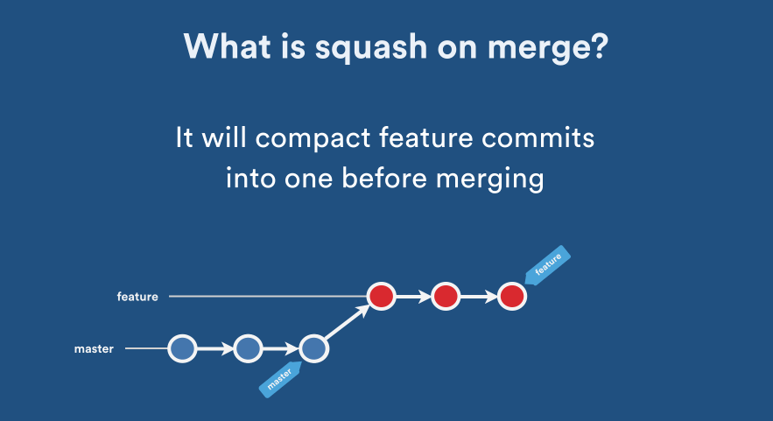
Squash Merge
Combines all changes from a branch into a single commit before merging.
Useful for keeping commit history clean.

Slide 14
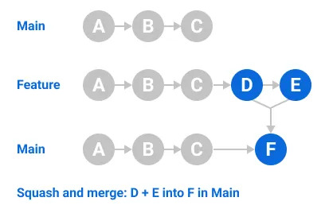
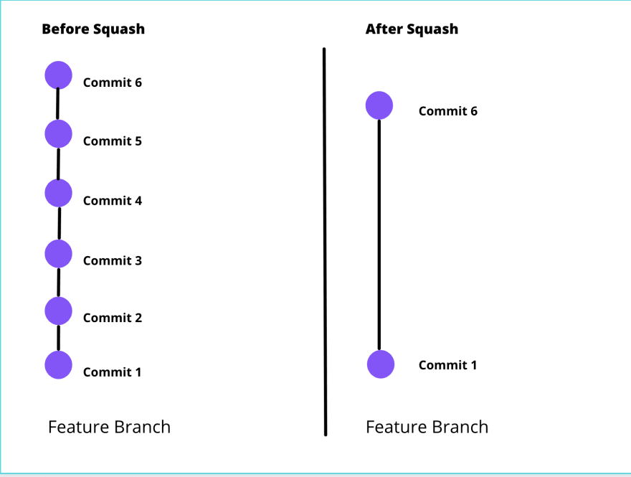
Example Scenario

Slide 15
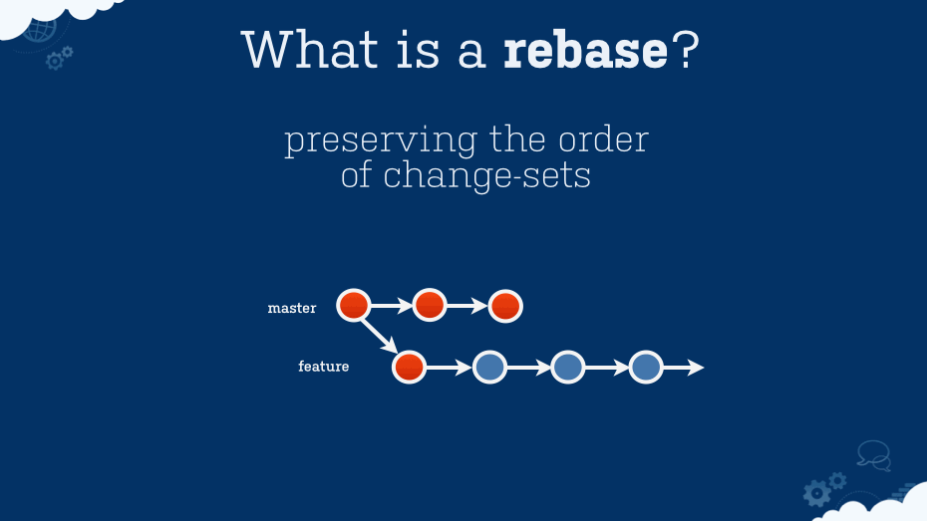
Rebase and Merge
Replays commits from one branch onto another, then merges.
Avoids merge commits and maintains a linear history.

Slide 16
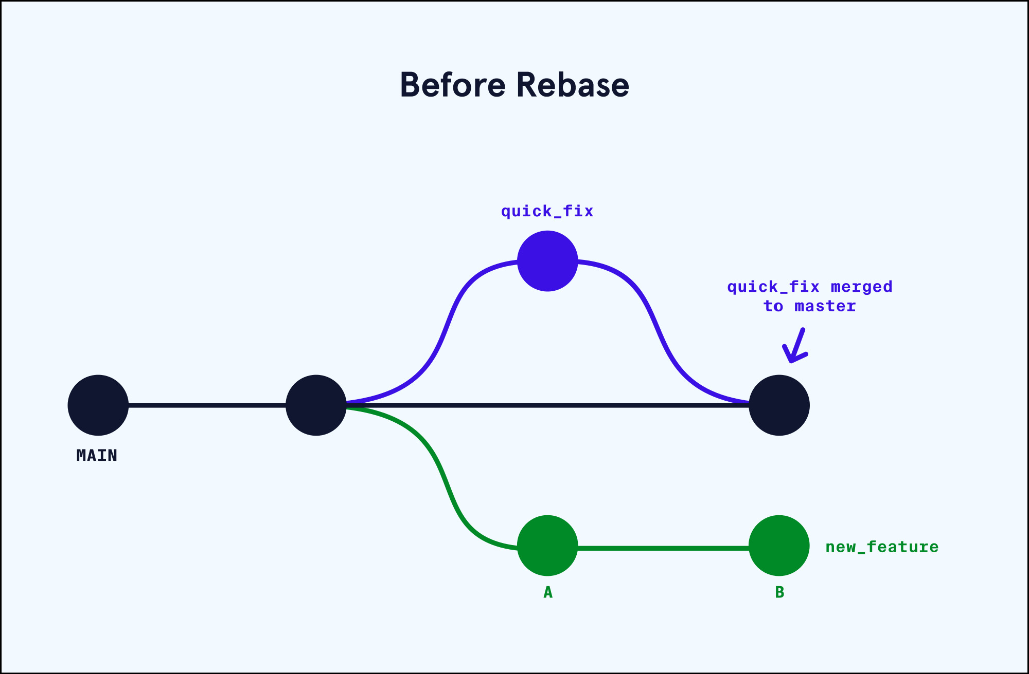
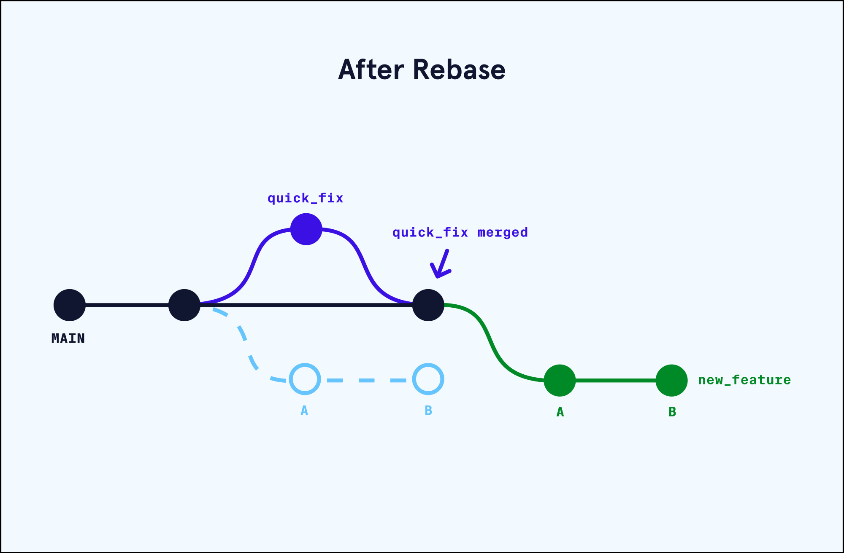
Example Scenario

Slide 17
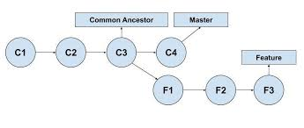
Three way Merge
Three-Way Merge combines changes from two branches.
Compares both branches to a common ancestor (version of the main branch from when you originally created the feature branch).
Resolves conflicts if the same code is changed in both branches.

Slide 18
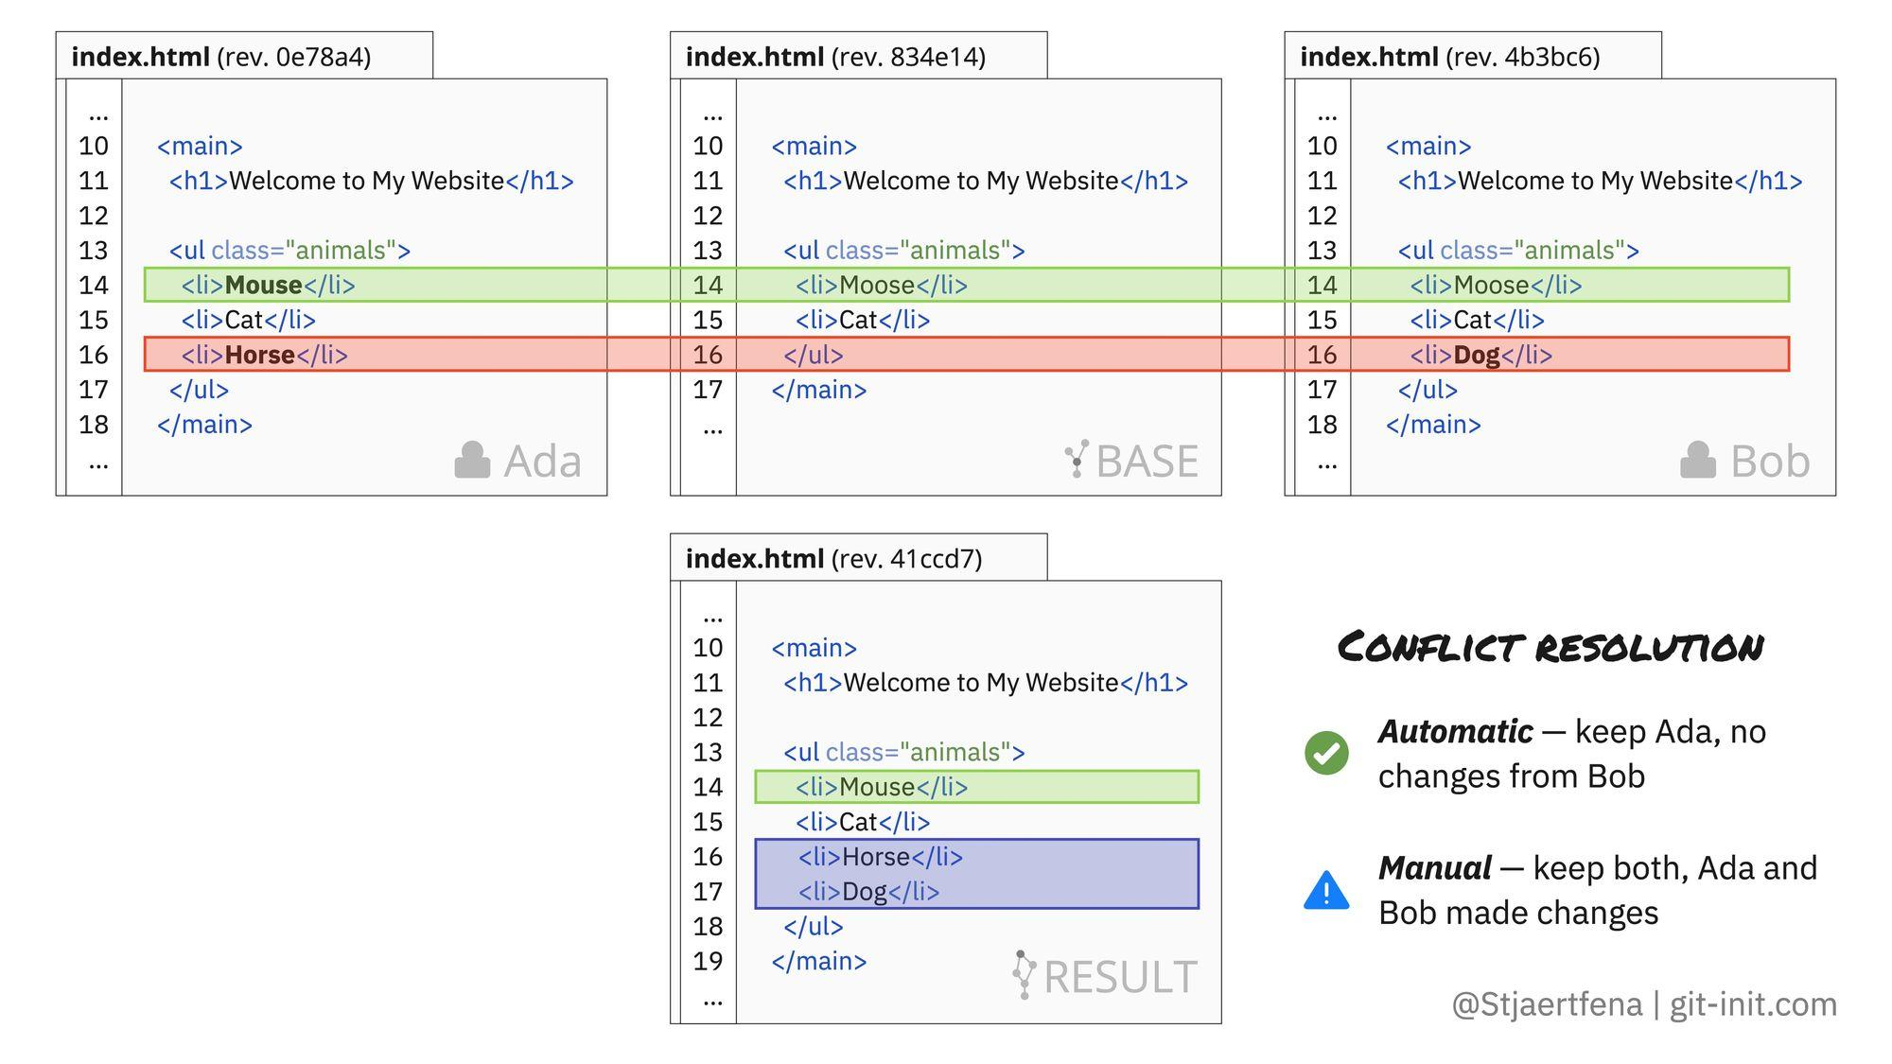
Example Scenario

Slide 19
Release Approaches
GitLab Flow
Trunk-Based Development
Git Flow

Slide 20
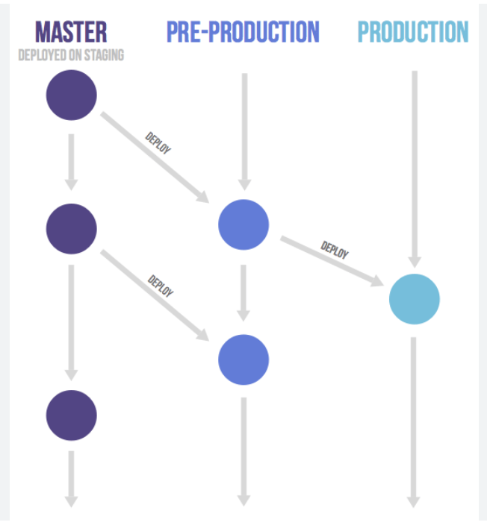
Gitlab Flow Approach
Branches - Master,Pre-production,Production.

Slide 21
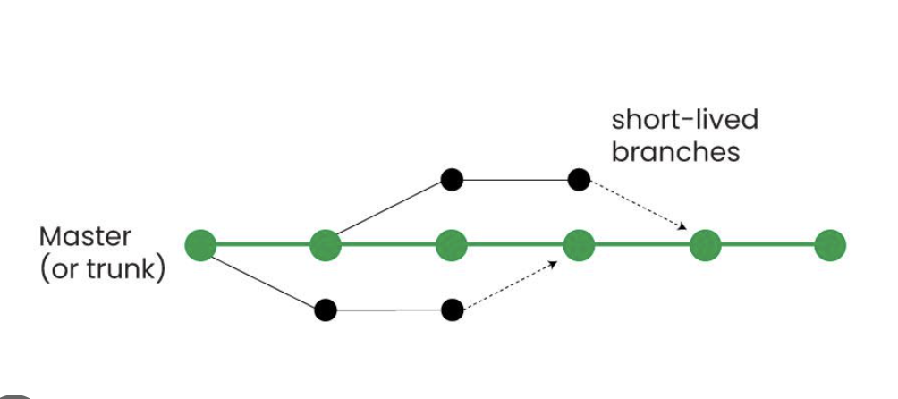
Trunk-Based Approach
Branches - Single main branch (trunk).

Slide 22
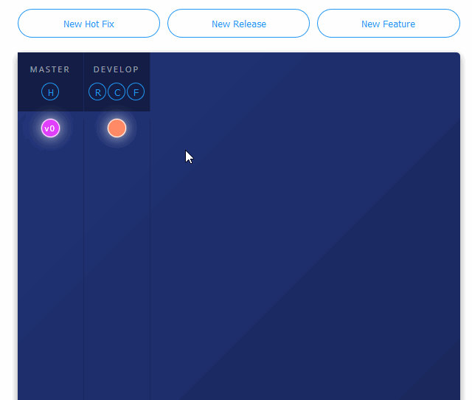
Git Flow Approach
Branches - Master, Develop, Feature, Release, Hotfix

Slide 23
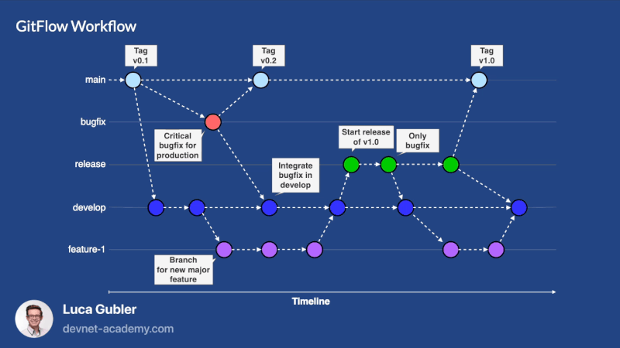
Best Approach

Slide 24
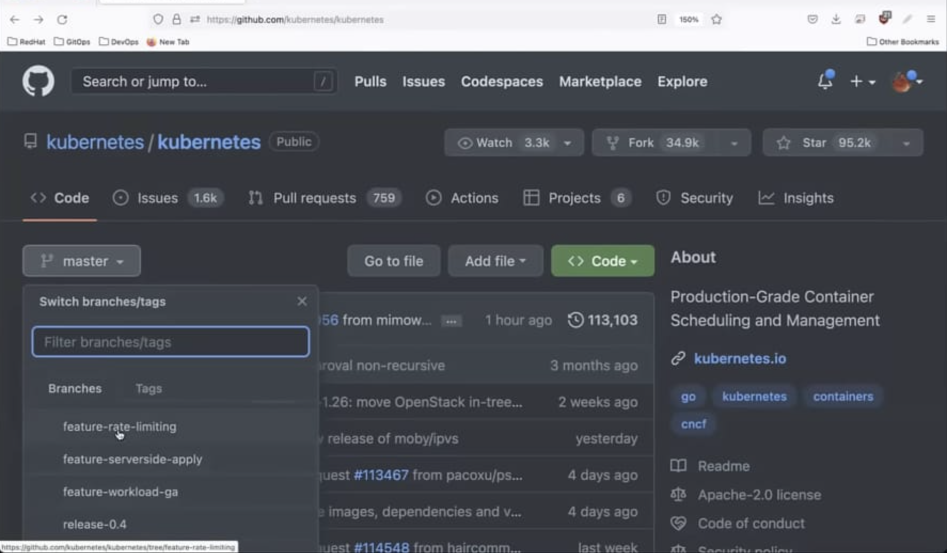
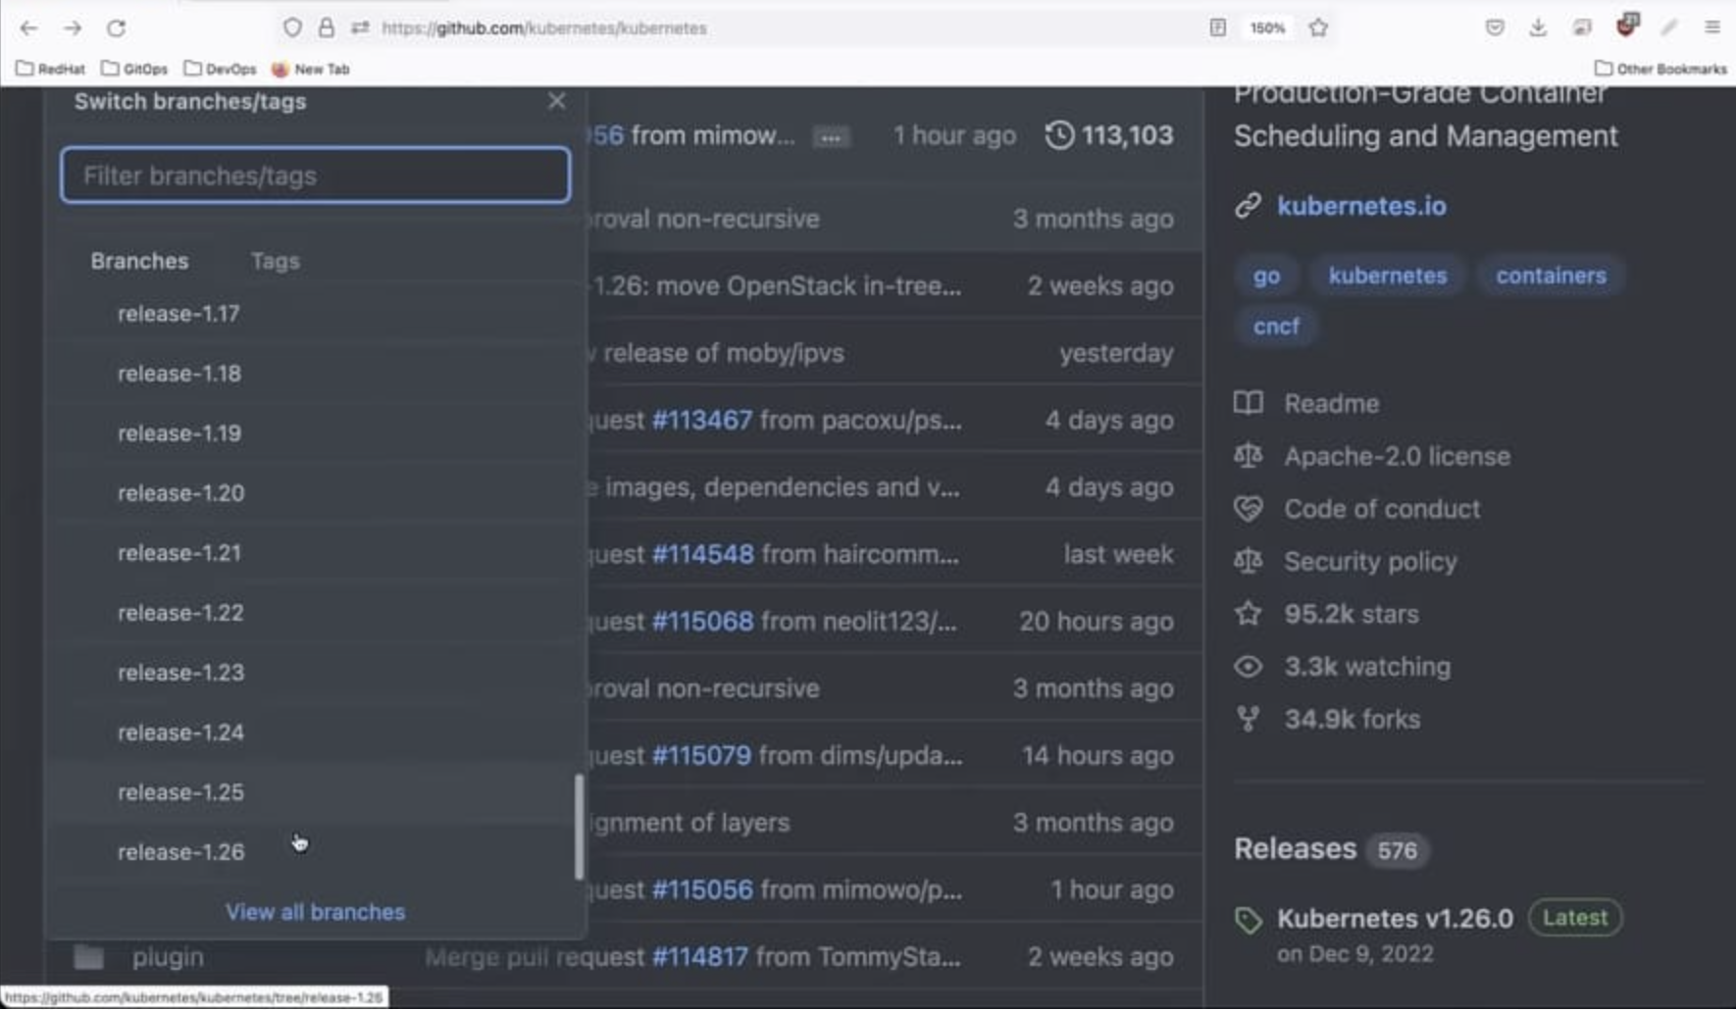
Example - Git Flow
Branches - Master, Develop, Feature, Release, Hotfix

Slide 25
Thank You

